Slide 1
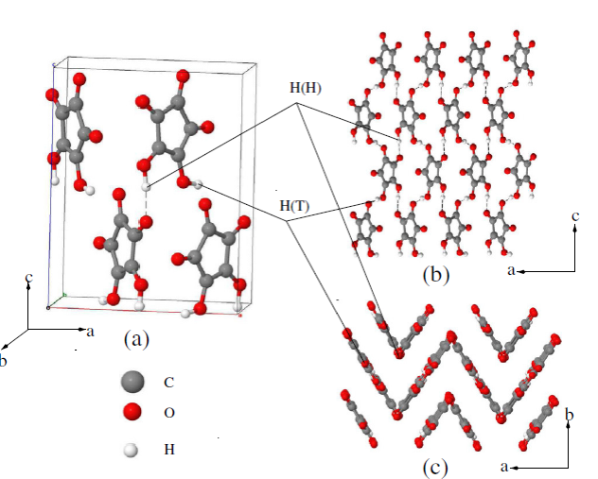
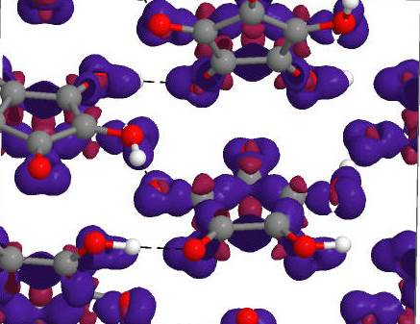
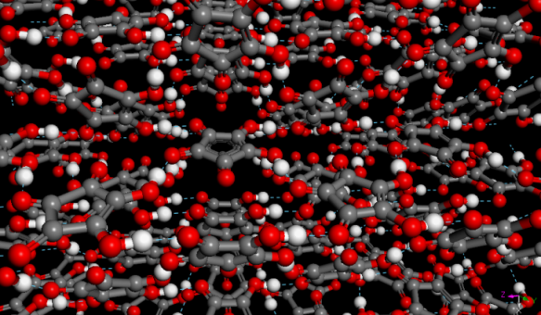
Virtual Experiments: Molecular Spectroscopy Sanghamitra Mukhopadhyay and Peter Willendrup
Notes:
OUTLINE
Welcome
Main purpose of update: setting the stage …
Instruments (reminder): unique-in-the-world suite set of high-resolution indirect spectrometers (with high-res diff) + increasing use of direct particularly for Catalysis.
Barriers across instruments are largely artificial as well as dynamic, e.g., OSIRIS upgrade project, TOSCA 40 Hz operation, Xpress systems, complementary use of TOSCA and MAPS on catalysis, possibilities to use muons as complementary spectral probes.
Overarching use of common analysis tools and computer modelling: MANTID project as a unified platform, heavy use of SCARF cluster, extension of TOSCA paradigm to low and high energy transfers.
Availability of additional sample characterisation equipment.
From the group’s point of view, it is important we to explore opportunities across instruments, possible upgrades and improvements of scientific infrastructure at ISIS, as well as how our science programme maps onto our spectroscopic and data-analysis capabilities – THIS IS THE MAIN MOTIVATION BEHIND THIS SCIENCE-DRIVEN USER MEETING.
Keeping You Informed: GOOD VIBRATIONS.
The Importance of Impact for STFC and the REF: IMPACT STUDIES.
Recruitment.
A few words about the scope of this meeting.

Slide 2
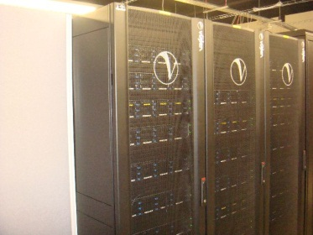
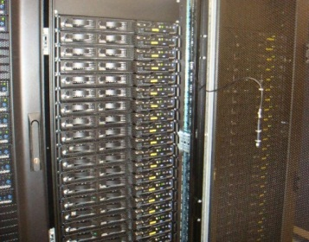
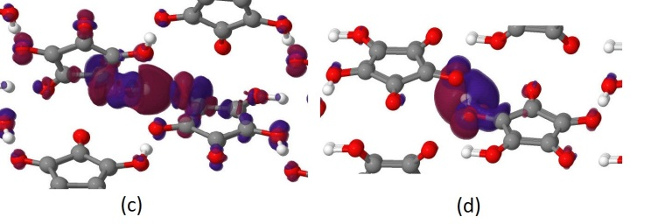



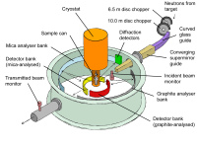

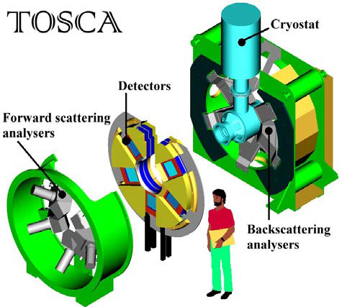
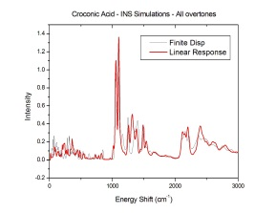

In-Silico Neutron Spectroscopy
Materials Modelling
High performance Computers
IRIS/OSIRIS
nMoldyn/MDANSE
W
Python Wrapper
Experiments
MANTID
Experiments

Slide 3
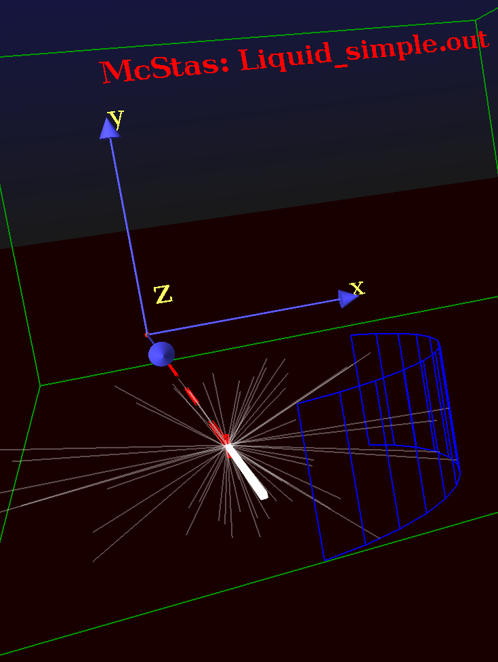
Virtual Experiments: Neutron Spectroscopy
High performance Computers
Materials Modelling
High performance Computers
nMoldyn/MDANSE
W
Python Wrapper
Virtual Experiments
MANTID
Virtual Experiments

Slide 4
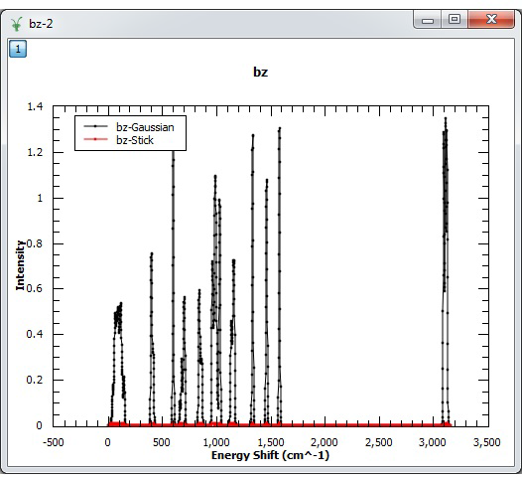
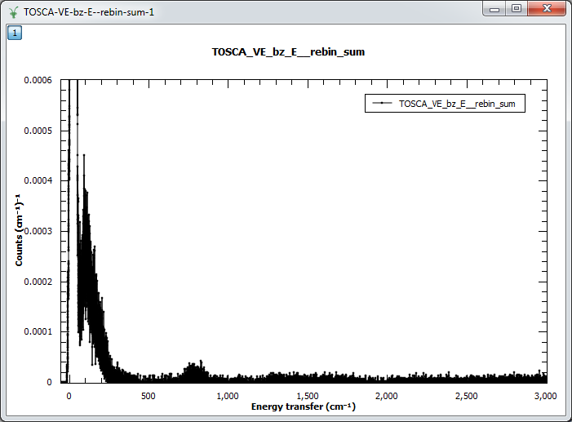
Virtual Experiments: Neutron Spectroscopy
S(Q,W)
CASTEP DFT Simulations Phonon file
VDOS
McStas Instrument TOSCA
Data reduction in MANTID
Data Virtual Experiments

Slide 5
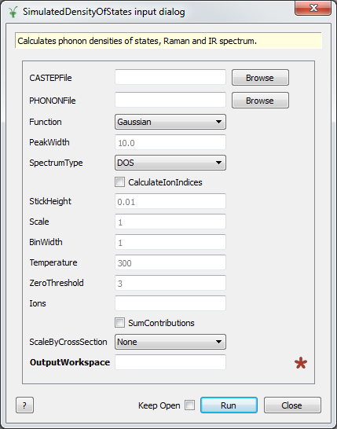
Virtual Experiments: Neutron Spectroscopy
CASTEP DFT Simulations Phonon file
VDOS

Slide 6
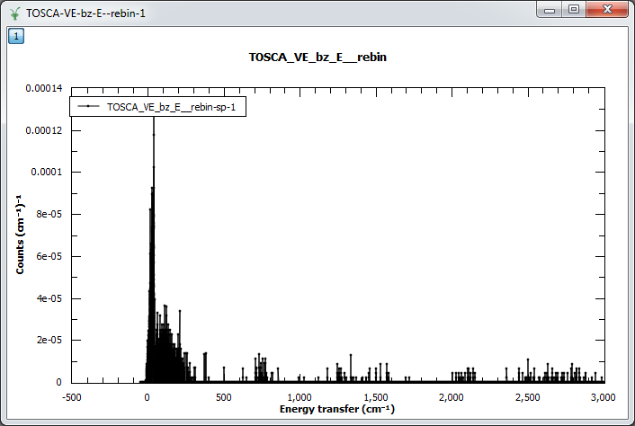
Virtual Experiments: Neutron Spectroscopy
VDOS
Data reduction in MANTID
S(Q,W)
McStas Instrument TOSCA
Single Detector

Slide 7
Virtual Experiments: Neutron Spectroscopy
VDOS
Data reduction in MANTID
S(Q,W)
McStas Instrument TOSCA
52 Detectors

Slide 8
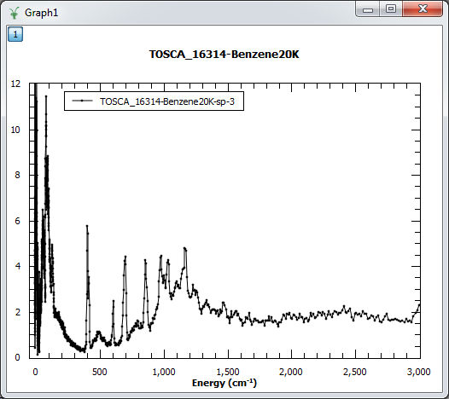
Virtual Experiments: Neutron Spectroscopy
VDOS
Data reduction in MANTID
S(Q,W)
McStas Instrument TOSCA
TOSCA Experiments

Slide 9
TOSCA, McStas Mantid

Slide 10
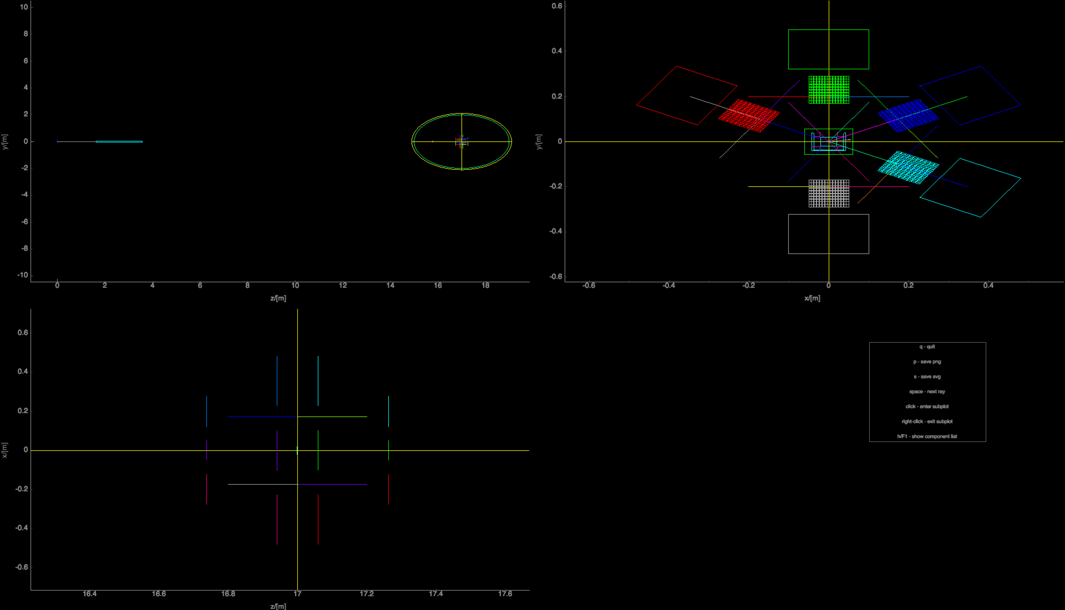
TOSCA in McStas - views along axes

Slide 11
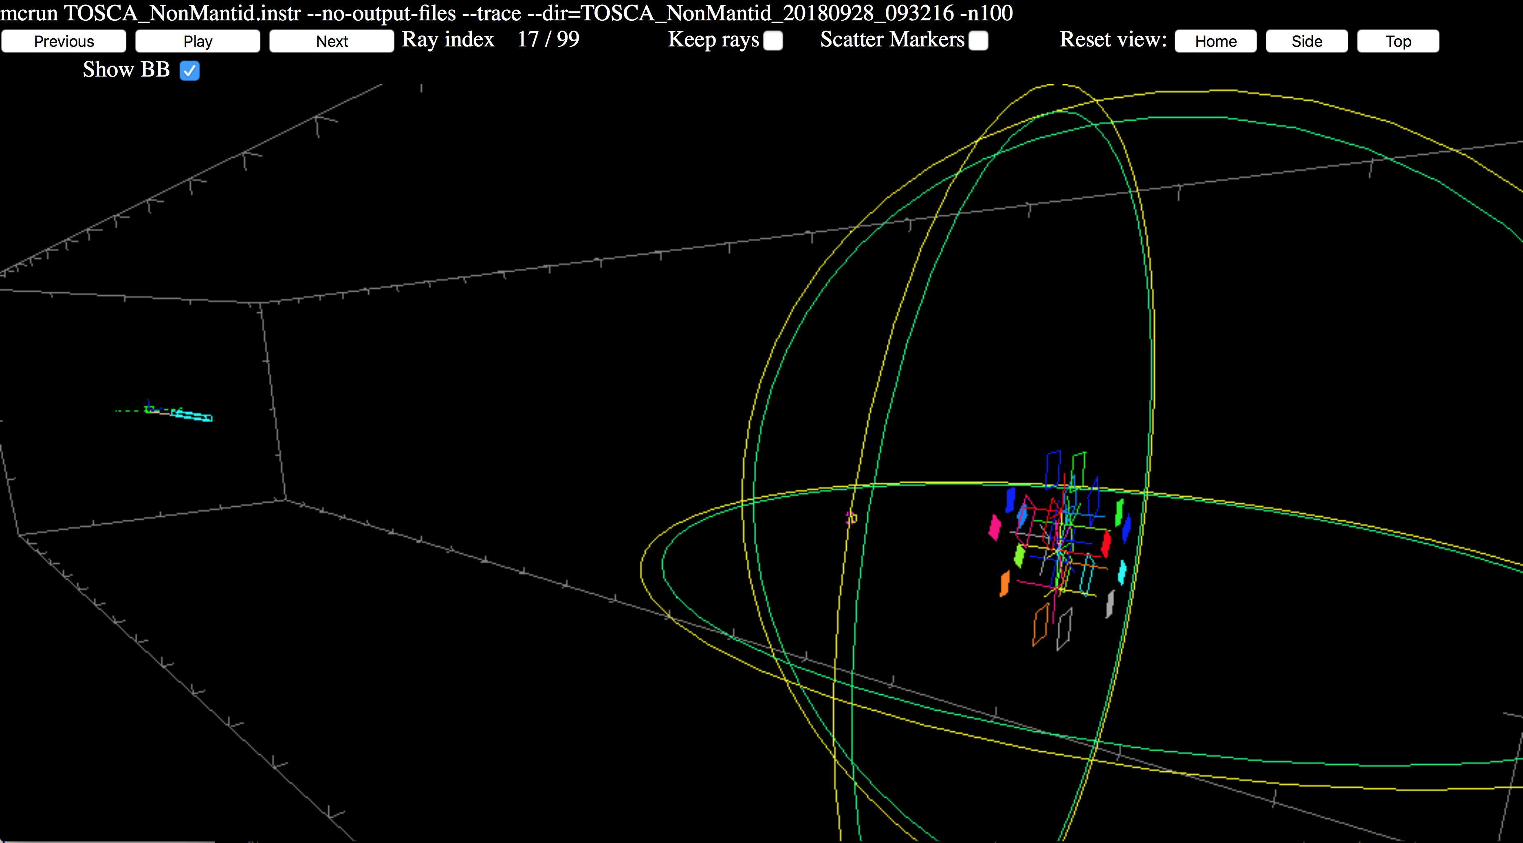
TOSCA in McStas - WEBGL view

Slide 12
TOSCA in McStas - WEBGL view
Available in DropBox MDANSE2018/Practical_I+N,_Molecular_spectroscopy/TOSCA_NonMantid_WEBGL/index.html

Slide 13
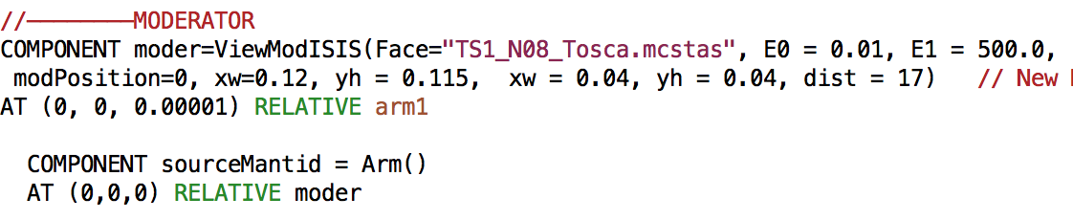
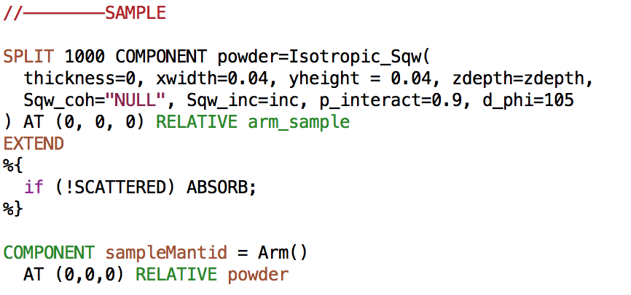
TOSCA transported in Mantid
(General recipe available in https://github.com/McStasMcXtrace/McCode/wiki/McStas-and-Mantid )
1. Mantid needs to know where the source is located
2. … and where the sample is located

Slide 14
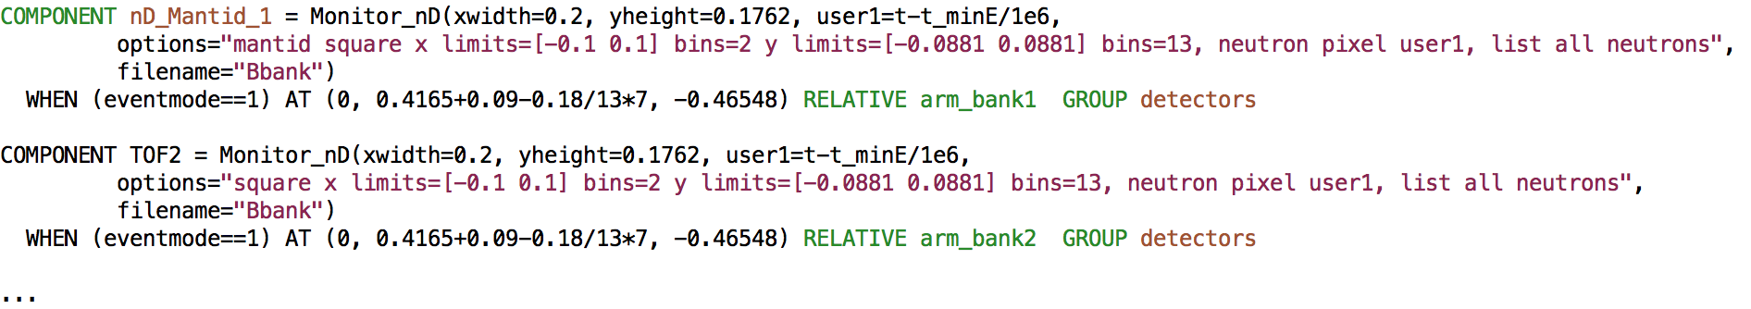
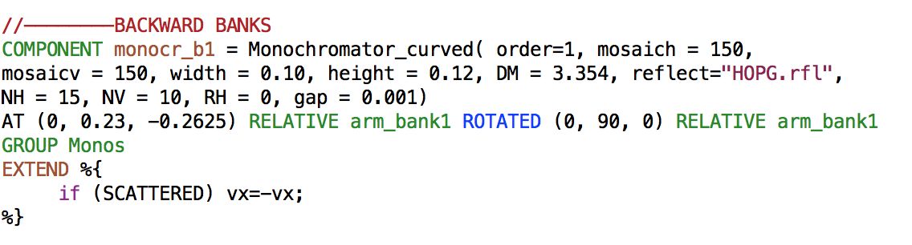
TOSCA transported in Mantid
3. Addition of a special series of event monitors - here first backward banks
4. Geometrical trick - since Mantid directly uses distance between sample and detector for kf calculation - the analysers are tricked to transmit the reflected beam
5. And detectors then placed behind the analysers instead of toward sample…
6. Recorded ToF is made relative to beam onset at sample

Slide 15
TOSCA transported in Mantid
3. Addition of a special series of event monitors - here first backward banks
4. Geometrical trick - since Mantid directly uses distance between sample and detector for kf calculation - the analysers are tricked to transmit the reflected beam
5. And detectors then placed behind the analysers instead of toward sample…
6. Recorded ToF is made relative to beam onset at sample

Slide 16
TOSCA transported in Mantid
6. Instrument must be compiled with NeXus capability
export MCSTAS_CFLAGS=“-g -lm -O2 -DUSE_NEXUS -lNeXus”
(MCSTAS_CFLAGS_OVERRIDE if using python tools)
7. IDF in xml format must be generated using mcdisplay.pl
mcdisplay TOSCA_Mantid_2.instr —format=Mantid -n0
-> TOSCA_Mantid_2.instr.xml
8. Simulation should generate NeXus output, i.e.
… demanding, required 4 hours using MPI on Quad-Core Intel i7 last night…
mcrun TOSCA_Mantid_2.instr inc=bz_inc_castep2.sqw eventmode=1 -n1e7 --format=NeXus
Energy range 0.01 - 500 meV

Slide 17
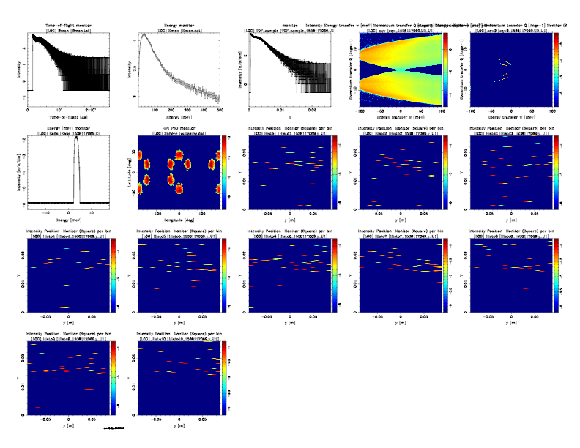
McStas output outside Mantid
--ncount 1e6

Slide 18
McStas output outside Mantid
Spectrum and ToF at sample position…

Slide 19
McStas output outside Mantid
S(q,⍵) as scattered by sample and what remains after
the analysers

Slide 20
McStas output outside Mantid
Absolute neutron energy and spatial location of beams on 4PI monitor…

Slide 21
McStas output outside Mantid
… result is relatively sparse in ToF on the individual
panels…

Slide 22
The event data are then reduced in Mantid
Steps:
ConvertUnits on event dataset, indirect geometry and Efixed of 1.85
Rebin dataset to achieve spectra
SumSpectra to get the final reduced dataset
Single Detector
52 Detectors

